Slide 1
Using Android Preferences
Week 10

Slide 2
Chapter 11
Overview
Determine when to work with application preferences
Store different types of preference values
Create private preferences for use by a single Activity
Create shared preferences for use by multiple activities
Search and read preferences
Add, update, and delete preferences
React to preference changes
Find preferences data on the Android file system
Create manageable user preferences
Create a preference resource file
Use the PreferenceActivity class
Organize preferences with headers

Slide 3
Working with Application Preferences
Many applications need a lightweight data storage mechanism called shared preferences for storing application state, simple user information, configuration options, and other such information
The Android SDK provides a simple preferences system for storing primitive application data at the Activity level and preferences shared across all of an application’s activities

Slide 4
Determining When Preferences Are Appropriate
Application preferences are sets of data values that are stored persistently
  This means that the preference data persists across application lifecycle events
  In other words, the application or device can be started and stopped, turned on and off, without losing the data
Many simple data values can be stored as application preferences, such as the username of the application user
The application could use a single preference to store this information
  The data type of the preference is a String
  The key for the stored value is a String called “UserName”
  The value for the data is the username “HarperLee1926”

Slide 5
Storing Different Types of Preference Values
Preferences are stored as groups of key/value pairs
The following data types are supported as preference setting values:
  Boolean values
  Float values
  Integer values
  Long values
  String values
  A Set of multiple String values (new as of API Level 11)

Slide 6
Storing Different Types of Preference Values (Cont’d)
Preference functionality can be found in the SharedPreferences interface of the android.content package
To add preferences support to your application, take the following steps:
  Retrieve an instance of a SharedPreferences object
  Create a SharedPreferences.Editor to modify the preference content
  Make changes to the preferences using the editor
  Commit your changes

Slide 7
Creating Private Preferences for Use by a Single Activity
Individual activities can have their own private preferences, though they are still represented by the SharedPreferences class
These preferences are for the specific Activity only and are not shared with other activities within the application
The Activity gets only one group of private preferences, which are simply named after the Activity class

Slide 8
Creating Private Preferences for Use by a Single Activity (Cont’d)
The following code retrieves an Activity class’s private preferences, called from within the Activity:
    import android.content.SharedPreferences;
    ...
    SharedPreferences settingsActivity =
    getPreferences(MODE_PRIVATE);
Notes:
Here we have retrieved the private preferences for that specific Activity class.
Because the underlying name is based on the Activity class, any change to the Activity class will change what preferences are read.

Slide 9
Creating Shared Preferences for Use by Multiple Activities
Creating shared preferences is similar
The only two differences are that we must name our preference set and use a different call to get the preference instance
  import android.content.SharedPreferences;
  ...
  SharedPreferences settings =
  getSharedPreferences("MyCustomSharedPreferences", MODE_PRIVATE);
Notes:
This code sample shows that we have retrieved the shared preferences for the application. You can access these shared preferences by name from any Activity in the application. There is no limit to the number of different shared preferences you can create. For example, you could have some shared preferences called “UserNetworkPreferences” and others called “AppDisplayPreferences”. How you organize shared preferences is up to you.

Slide 10
Creating Shared Preferences for Use by Multiple Activities (Cont’d)
You should declare the name of your preferences as a variable so that you can reuse the name across multiple activities consistently
Here’s an example:
public static final String PREFERENCE_FILENAME =
"AppPrefs";

Slide 11
Searching and Reading Preferences
Method | Purpose
SharedPreferences.contains() | Sees whether a specific preference exists by name
SharedPreferences.edit() | Retrieves the editor to change these preferences
SharedPreferences.getAll() | Retrieves a map of all preference key/value pairs
SharedPreferences.getBoolean() | Retrieves a specific Boolean-type preference by name
SharedPreferences.getFloat() | Retrieves a specific Float-type preference by name
SharedPreferences.getInt() | Retrieves a specific Integer-type preference by name
SharedPreferences.getLong() | Retrieves a specific Long-type preference by name
SharedPreferences.getString() | Retrieves a specific String-type preference by name
SharedPreferences.getStringSet() | Retrieves a specific Set of String preferences by name (method added in API Level 11)
Notes:
Reading preferences is straightforward. Simply retrieve the SharedPreferences instance you want to read. You can check for a preference by name, retrieve strongly typed preferences, and register to listen for changes to the preferences. This table describes some helpful methods in the SharedPreferences interface.

Slide 12
Adding, Updating, and Deleting Preferences
Method | Purpose
SharedPreferences.Editor.clear() | Removes all preferences
SharedPreferences.Editor.remove() | Removes a specific preference by name
SharedPreferences.Editor.putBoolean() | Sets a specific Boolean-type preference by name
SharedPreferences.Editor.putFloat() | Sets a specific Float-type preference by name
SharedPreferences.Editor.putInt() | Sets a specific Integer-type preference by name
SharedPreferences.Editor.putLong() | Sets a specific Long-type preference by name
SharedPreferences.Editor.putString() | Sets a specific String-type preference by name
SharedPreferences.Editor.putStringSet() | Sets a specific Set of String-type preferences by name (method added in API Level 11)
SharedPreferences.Editor.commit() | Commits all changes from this editing session
SharedPreferences.Editor.apply() | Much like the commit() method
Notes:
To change preferences, you need to open the preference editor, make your changes, and commit them. This table describes some helpful methods in the SharedPreferences.Editor interface.

Slide 13
Adding, Updating, and Deleting Preferences (Cont’d)
The following block of code retrieves an Activity class’s private preferences, opens the preference editor, adds a Long-type preference called SomeLong, and saves the change:
  import android.content.SharedPreferences;
  ...
  SharedPreferences settingsActivity = getPreferences(MODE_PRIVATE);
  SharedPreferences.Editor prefEditor = settingsActivity.edit();
  prefEditor.putLong("SomeLong", java.lang.Long.MIN_VALUE);
  prefEditor.commit();

Slide 14
Reacting to Preference Changes
Your application can listen for, and react to, changes to shared preferences by implementing a listener and registering it with the specific SharedPreferences object using the registerOnSharedPreferenceChangeListener() and unregisterOnSharedPreferenceChangeListener() methods
This interface class has just one callback, which passes your code the shared preferences object that changed and which specific preference key name changed

Slide 15
Finding Preferences Data on the Android File System
Internally, application preferences are stored as XML files
You can access the preferences file using the File Explorer via DDMS
You find these files on the Android file system in the following directory:
/data/data/<package name>/shared_prefs/<preferences filename>.xml

Slide 16
Finding Preferences Data on the Android File System (Cont’d)
The preferences filename is the Activity class name for private preferences or the specific name you give for the shared preferences
<?xml version="1.0" encoding="utf-8" standalone="yes" ?>
<map>
<string name="String_Pref">Test String</string>
<int name="Int_Pref" value="-2147483648" />
<float name="Float_Pref" value="-Infinity" />
<long name="Long_Pref" value="9223372036854775807" />
<boolean name="Boolean_Pref" value="false" />
</map>
Notes:
The following XML is the contents of a preferences file with some simple values.

Slide 17
Finding Preferences Data on the Android File System (Cont’d)
Understanding the application preferences file format can be helpful for testing purposes
You can use Dalvik Debug Monitor Service (DDMS) to copy the preferences files to and from the device
Since the shared preferences are just a file, regular file permissions apply
When creating the file, you specify the mode (permissions) for the file to determine if the file is readable outside of the existing package

Slide 18
Creating Manageable User Preferences
You now understand how to store and retrieve shared preferences programmatically
If you have a set of user settings and want to create a simple, consistent, and platform-standard way in which the user can edit them, you can use the PreferenceActivity class
  android.preference.PreferenceActivity

Slide 19
Creating Manageable User Preferences (Cont’d)
Implementing a PreferenceActivity-based solution requires the following steps:
  Define the preference set in a preference resource file
  Implement a PreferenceFragment class and tie it to the preference resource file
    Note that PreferenceFragment will work only on Android 3.0 and above
    In the interest of backward compatibility, a PreferenceActivity without the PreferenceFragment can be used to support legacy platform versions as needed
  Implement a PreferenceActivity class and add the PreferenceFragment you just created
  Hook up the activity within your application as you normally would
    For example, register it in the manifest file, start the Activity as normal, and so on

Slide 20
Creating a Preference Resource File
Create an XML resource file to define the preferences your users are allowed to edit
A preference resource file contains a root-level <PreferenceScreen> tag, followed by various preference types
These preference types are based on the Preference class (android.preference.Preference) and its subclasses
  CheckBoxPreference
  EditTextPreference
  ListPreference
  MultiSelectListPreference
  And others

Slide 21
Creating a Preference Resource File (Cont’d)
Each preference should have some metadata, such as a title and some summary text that will be displayed to the user
You can also specify default values and, for those preferences that launch dialogs, the dialog prompt
For the specific metadata associated with a given preference type, see its subclass attributes in the Android SDK documentation

Slide 22
Creating a Preference Resource File (Cont’d)
Here are some common Preference attributes that most preferences should set:
  The android:key attribute is used to specify the key name for the shared preference
  The android:title attribute is used to specify the friendly name of the preference, as shown on the editing screen
  The android:summary attribute is used to give more details about the preference, as shown on the editing screen
  The android:defaultValue attribute is used to specify a default value of the preference

Slide 23
Creating a Preference Resource File (Cont’d)
  <PreferenceScreen
  xmlns:android="http://schemas.android.com/apk/res/android">
  <PreferenceCategory
  android:title="Game Settings">
  <CheckBoxPreference
  android:key="bSoundOn"
  android:title="Enable Sound"
  android:summary="Turn sound on and off in the game"
  android:defaultValue="true" />
  <CheckBoxPreference
  android:key="bAllowCheats"
  android:title="Enable Cheating"
  android:summary=
  "Turn the ability to cheat on and off in the game"
  android:defaultValue="false" />
  </PreferenceCategory>
  </PreferenceScreen>
Notes:
Like any resource files, preference resource files can use raw strings or reference string resources. The following preference resource file example does a bit of both (the string array resources are defined elsewhere in the strings.xml resource file).
This XML preference file is organized into categories and defines fields for collecting several pieces of information.
For instance, this example uses the CheckBoxPreference type to manage Boolean shared preference values, for example, game settings such as whether or not sound is enabled or whether cheating is allowed. Boolean values are checked on and off straight from the screen. Finally, the settings are organized into categories using <PreferenceCategory> tags.

Slide 24
Using the PreferenceActivity Class
The PreferenceActivity class is a helper class that is capable of displaying a PreferenceFragment
  android.preference.PreferenceActivity
This PreferenceFragment loads up your XML preferences resource file and transforms it into a standard settings screen, much as you see in the Android device settings

Slide 25
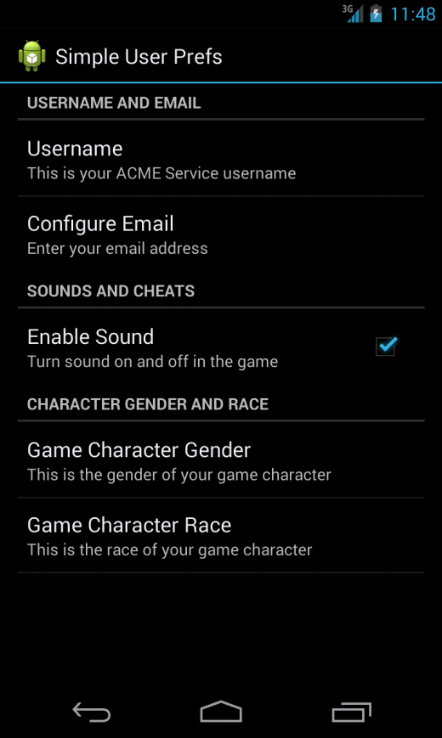
Using the PreferenceActivity Class (Cont’d)
Notes:
This figure shows an example of a preference resource file when loaded into a PreferenceActivity class.

Slide 26
Using the PreferenceActivity Class (Cont’d)
To wire up your new preference resource file, create a new class that extends the PreferencesActivity class within your application
Next, override the onCreate() method of your class
Retrieve the FragmentManager for the Activity, start a FragmentTransaction, insert your PreferenceFragment into the Activity, and then call commit()
Tie the preference resource file to the PreferenceFragment class using the addPreferencesFromResource() method
You will also want to retrieve an instance of the PreferenceManager (android.preference.PreferenceManager) and set the name of these preferences for use in the rest of your application, if you’re using a name other than the default

Slide 27
Using the PreferenceActivity Class (Cont’d)
public class SimpleUserPrefsActivity extends PreferenceActivity {
@Override
public void onCreate(Bundle savedInstanceState) {
super.onCreate(savedInstanceState);
FragmentManager manager = getFragmentManager();
FragmentTransaction transaction = manager.beginTransaction();
transaction.replace(android.R.id.content,
new SimpleUserPrefsFragment()).commit();
}
public static class SimpleUserPrefsFragment extends PreferenceFragment {
@Override
public void onCreate(Bundle savedInstanceState) {
super.onCreate(savedInstanceState);
PreferenceManager manager = getPreferenceManager();
manager.setSharedPreferencesName("user_prefs");
addPreferencesFromResource(R.xml.userprefs);
}
}
}
Notes:
Here is the complete implementation of the SimpleUserPrefsActivity class.
Now you can simply wire up the activity as you normally would. Don’t forget to register it within your application’s Android manifest file.

Slide 28
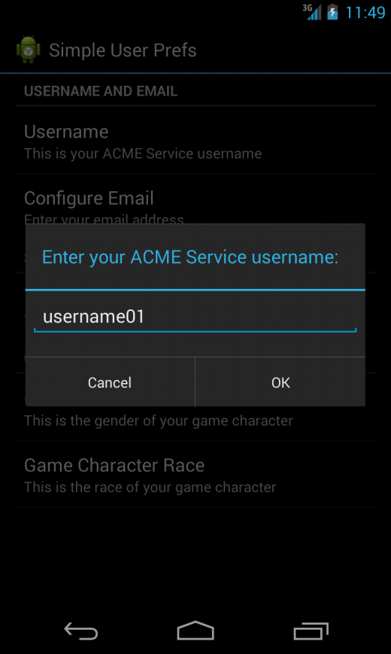
Using the PreferenceActivity Class (Cont’d)
Notes:
Here is a screen capture of using the EditTextPreference type to manage string shared preference values, such as usernames.

Slide 29
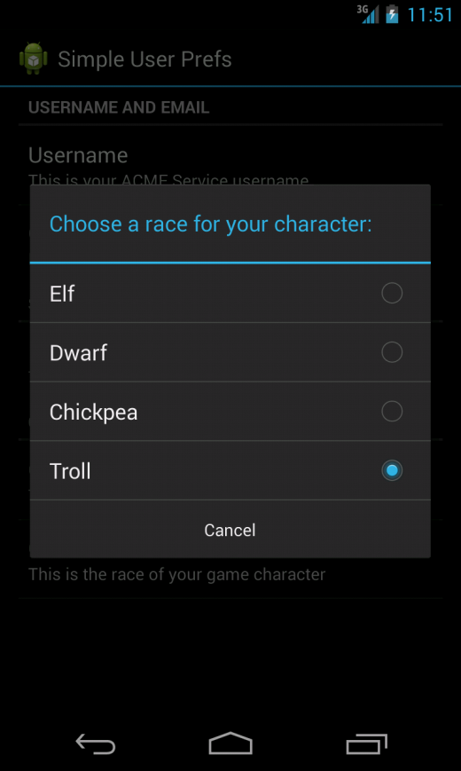
Using the PreferenceActivity Class (Cont’d)
Notes:
Here is a screen capture that uses the ListPreference type to force the user to choose from a list of options.

Slide 30
Organizing Preferences with Headers
Added in Android 3.0 (API Level 11) is the concept of Preference headers
The headers feature allows your application to present a list of options for navigating to setting subscreens
A good example of a system application that uses the headers feature is the Android system Settings application
On large-screen devices, the left pane displays the setting list items and, depending on which setting item is selected, determines what setting options are displayed in the right pane

Slide 31
Organizing Preferences with Headers (Cont’d)
There are a few setup steps for making your application ready for incorporating the Preference headers feature:
  Create individual PreferenceFragment classes for each setting collection
  Define the header list using the <preference-headers> tag in a new XML file
  Create a new PreferenceActivity class that calls the method onBuildHeaders() for loading the headers resource file

Slide 32
Organizing Preferences with Headers (Cont’d)
<preference-headers xmlns:android="http://schemas.android.com/apk/res/android">
<header
android:fragment=
"com.androidintro.userprefs.UserPrefsActivity$UserNameFrag"
android:title="Personal Settings"
android:summary="Configure your personal settings" />
<header
android:fragment=
"com.androidintro.userprefs.UserPrefsActivity$GameSettingsFrag"
android:title="Game Settings"
android:summary="Configure your game settings" />
<header
android:fragment=
"com.androidintro.userprefs.UserPrefsActivity$CharSettingsFrag"
android:title="Character Settings"
android:summary="Configure your character settings" />
</preference-headers>
Notes:
An example headers file is shown here, which groups settings into separate header entries.
We have defined three headers, each with a Fragment, title, and summary defined.

Slide 33
Organizing Preferences with Headers (Cont’d)
public class UserPrefsActivity extends PreferenceActivity {
@Override
public void onCreate(Bundle savedInstanceState) {
super.onCreate(savedInstanceState);
}
@Override
public void onBuildHeaders(List<Header> target) {
loadHeadersFromResource(R.xml.preference_headers, target);
}
public static class UserNameFrag extends PreferenceFragment {
@Override
public void onCreate(Bundle savedInstanceState) {
super.onCreate(savedInstanceState);
PreferenceManager manager = getPreferenceManager();
manager.setSharedPreferencesName("user_prefs");
addPreferencesFromResource(R.xml.personal_settings);
}
}
}
Notes:
Here is how our new UserPrefsActivity class could look, with only one of the PreferenceFragments defined.

Slide 34
Organizing Preferences with Headers (Cont’d)
<PreferenceScreen xmlns:android="http://schemas.android.com/apk/res/android">
<PreferenceCategory
android:title="Username and Email">
<EditTextPreference
android:key="username"
android:title="Username"
android:summary="This is your ACME Service username"
android:defaultValue="username01"
android:dialogTitle="Enter your ACME Service username:" />
<EditTextPreference
android:key="email"
android:title="Configure Email"
android:summary="Enter your email address"
android:defaultValue="your@email.com" />
</PreferenceCategory>
</PreferenceScreen>
Notes:
For the sake of clarity, we will show just one of the <PreferenceScreen> files.

Slide 35
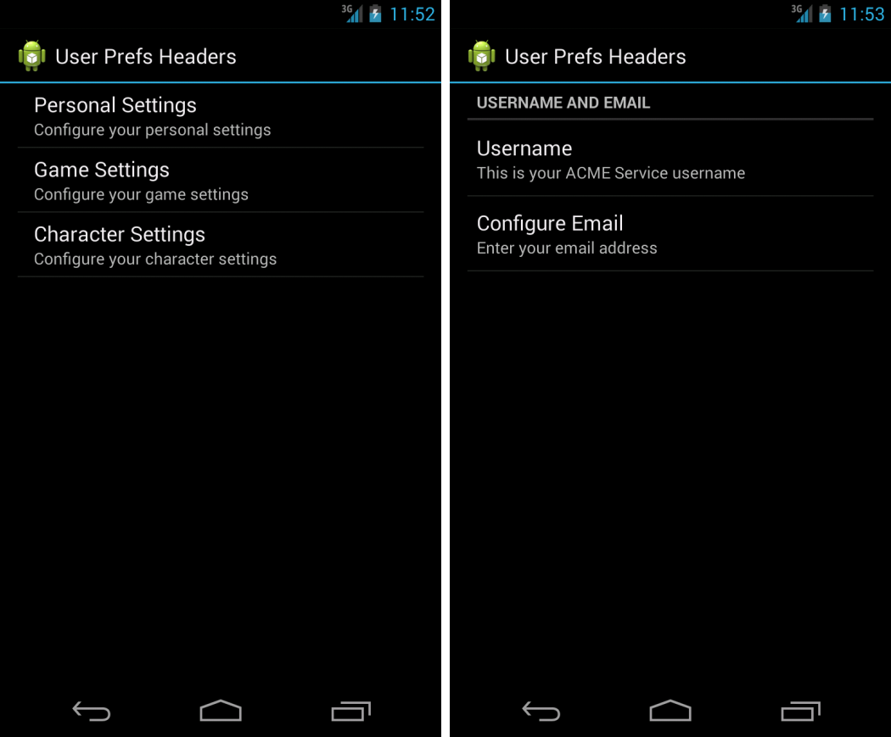
Organizing Preferences with Headers (Cont’d)
Notes:
Here is how the settings are displayed on a single-pane screen.

Slide 36
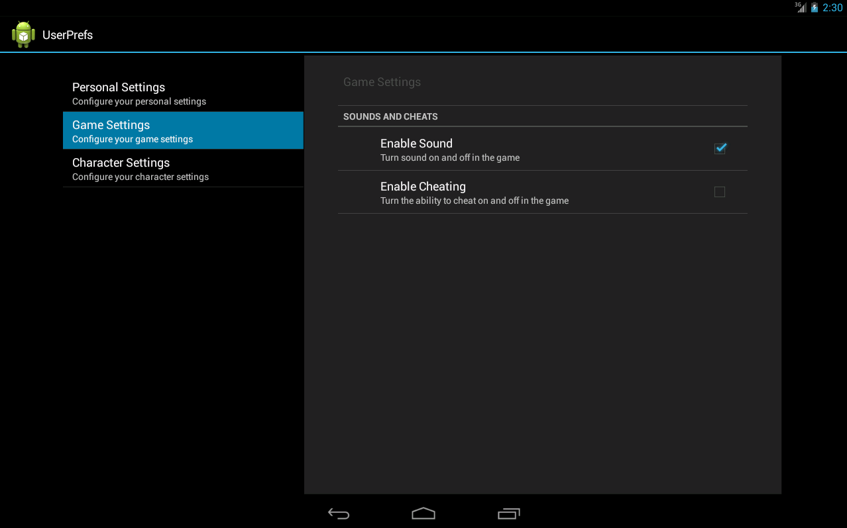
Organizing Preferences with Headers (Cont’d)
Notes:
Here is how the settings are displayed on two-pane large screen.

Slide 37
Learning about Cloud Save for Android Applications
Google Play Game Services now includes a feature called Cloud Save
This service allows you to save user application state information to the cloud easily, much like a set of preferences
The difference is that this data will persist across a user’s different devices
  For example, a game application might use Cloud Save to store a user’s game level and sync the game level across the user’s devices, so he or she doesn’t have to start all over again when playing the same application on a different device
In case a user loses a device, or needs to reinstall the game for some reason, the proper information can be restored easily without any loss of data
You can think of Cloud Save as a set of remote preferences
Application developers can save a reasonable amount of data (currently 128KB) for their users with Cloud Save
This service is not meant to replace a back-end data storage mechanism
To learn more about the Cloud Save service, see https://developers.google.com/games/services/android/cloudsave

